Slide 1
Debugging Embedded Devices Remotely At Scale
Tyler Hoffman, Co-Founder, Memfault

Slide 2




Tyler Hoffman
Co-Founder & Lead Engineer, Memfault
I love developer tools, primarily for embedded engineers
Previously: Firmware Engineer @ Pebble, Fitbit
I write on Memfault’s Interrupt blog and give talks. (https://interrupt.memfault.com)
Notes:
Hello! I’m pumped to be here.

Slide 3
Agenda
Debugging remotely is hard
What is a Coredump?
Coredump Capabilities
Offensive Programming with Coredumps
Best Practices

Slide 4
Debugging remotely is hard
… if not sometimes impossible
Notes:
Examples
Pair with a good diagnostics system
Memfault side-by-side
Why Memfault?
Because half-way across the world!

Slide 5
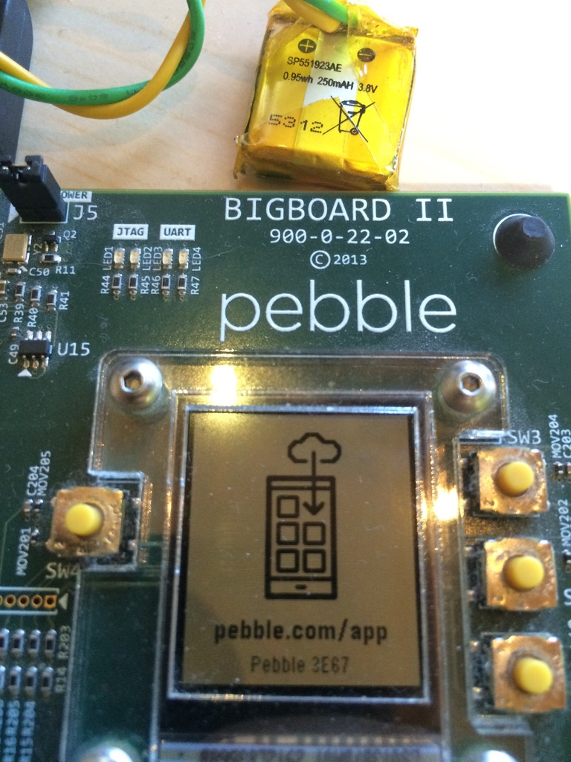
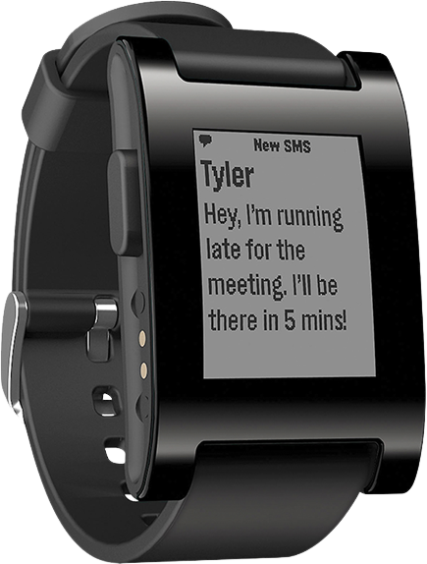
Embedded debugging is the hardest
👍
Easy
We have to build everything from scratch
We don’t always have our JTAG, UART, or USB connections
Everything consumes power, flash cycles, bandwidth, and developer resources
Reproducing bugs is hard if not impossible
End-to-end logging pipeline is not trivial
🔥
Difficult

Slide 6

Many kinds of bugs with embedded
Timing Issues
Performance Issues
Deadlocks & race conditions
UI lag
Power Regression
Crashes
Hardware stayed on
MCU sleep issue
Asserts
Hard faults, memory faults, bus faults
Memory corruption
Resource Exhaustion
Connectivity Issues
Out of memory (heaps)
Stack overflow
Disconnects
Slow transfer speed
“It didn’t work”
Debugging these remotely is today’s topic

Slide 7
We can easily root cause and fix these issues with the use of coredumps

Slide 8
What is a Coredump?
Notes:
Examples
Pair with a good diagnostics system
Memfault side-by-side
Why Memfault?
Because half-way across the world!

Slide 9
What is a coredump?
A snapshot of RAM regions at a specific moment in time.
Can be captured on command, or at time of a fault
Greatly helps with post-mortem debugging
Requires symbol file & clever parsing
Semi-supported by:
ESP-IDF, Zephyr RTOS, MyNewt RTOS
Any RTOS with Memfault
Coredump
Timestamp
Memory Regions
Address, Size
Memory Regions
Address, Size
Memory Regions
Address, Size
Firmware Version
Build ID
Coredump Reason
Architecture
Device Serial

Slide 10
Capturing a coredump
Coredump
void HardFault_Handler(void) {
// Capture coredump FIRST
capture_coredump();
// Then reset
NVIC_SystemReset();
}
Timestamp
Memory Regions
Address, Size
Memory Regions
Address, Size
Memory Regions
Address, Size
Firmware Version
Build ID
Coredump Reason
Architecture
Device Serial

Slide 11
Capturing a coredump
When a coredump capture has triggered, persist to memory or external flash:
Current registers
Desired memory regions
Coredump metadata (SW, HW, device serial, etc.)
Coredump CRC
Simplest coredump to save is all of RAM (~100kB+)
Minimal coredump can get full stacktrace & few global variables (~1-2kB)

Slide 12

Using a coredump
Simplest: retrieve via console
More common: send via HTTP to server
Most common: arbitrary transport to server
GDB Server
(with coredump)
Coredump Saved
Developer Computer
Retrieved
UART
BLE via phone
Gateway
USB
SD card
???
GDB
(with symbol file)

Slide 13
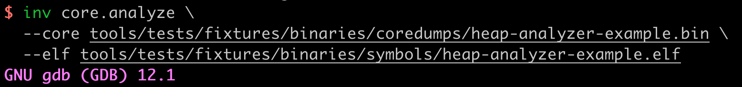
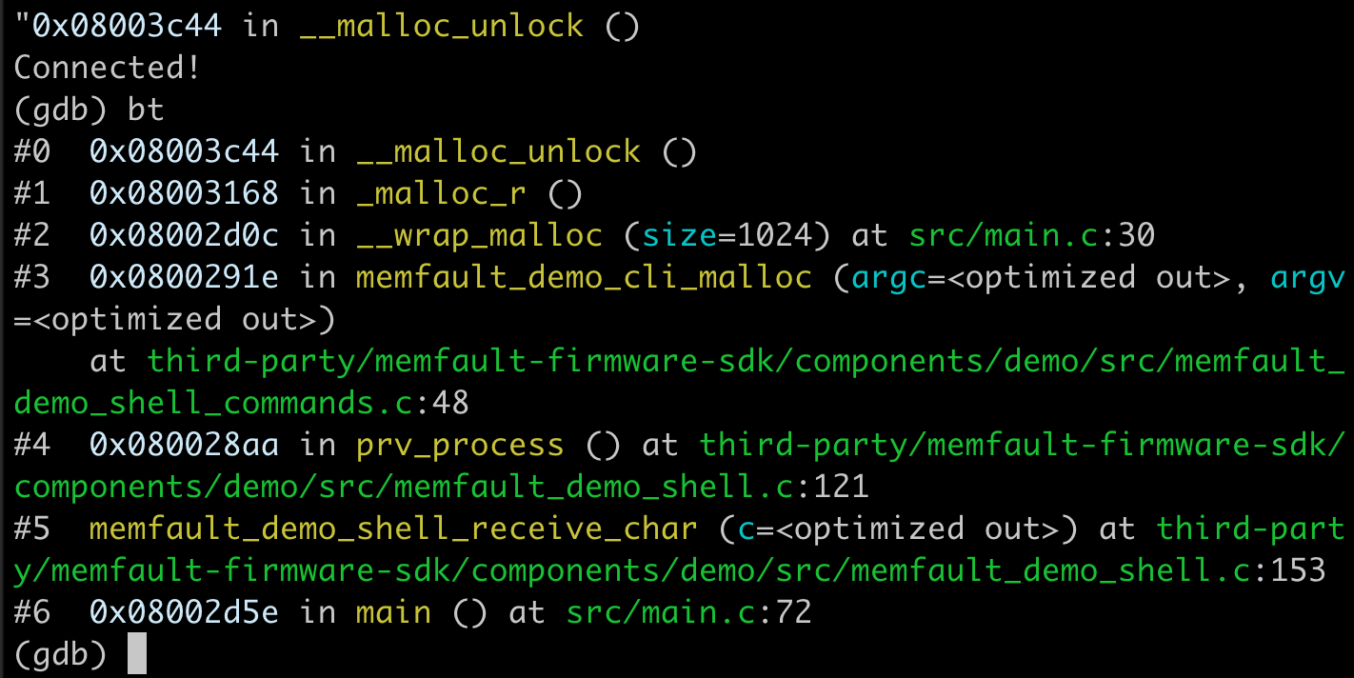

Slide 14
What does a coredump provide?
Notes:
Examples
Pair with a good diagnostics system
Memfault side-by-side
Why Memfault?
Because half-way across the world!

Slide 15

What’s in a coredump?
Threads and stack traces
Heap allocations and statistics
Global variables
Local variables and function arguments
System and peripheral registers
Anything else you want to collect (and parse)
**https://interrupt.memfault.com/blog/instruction-tracing-mtb-m33

Slide 16
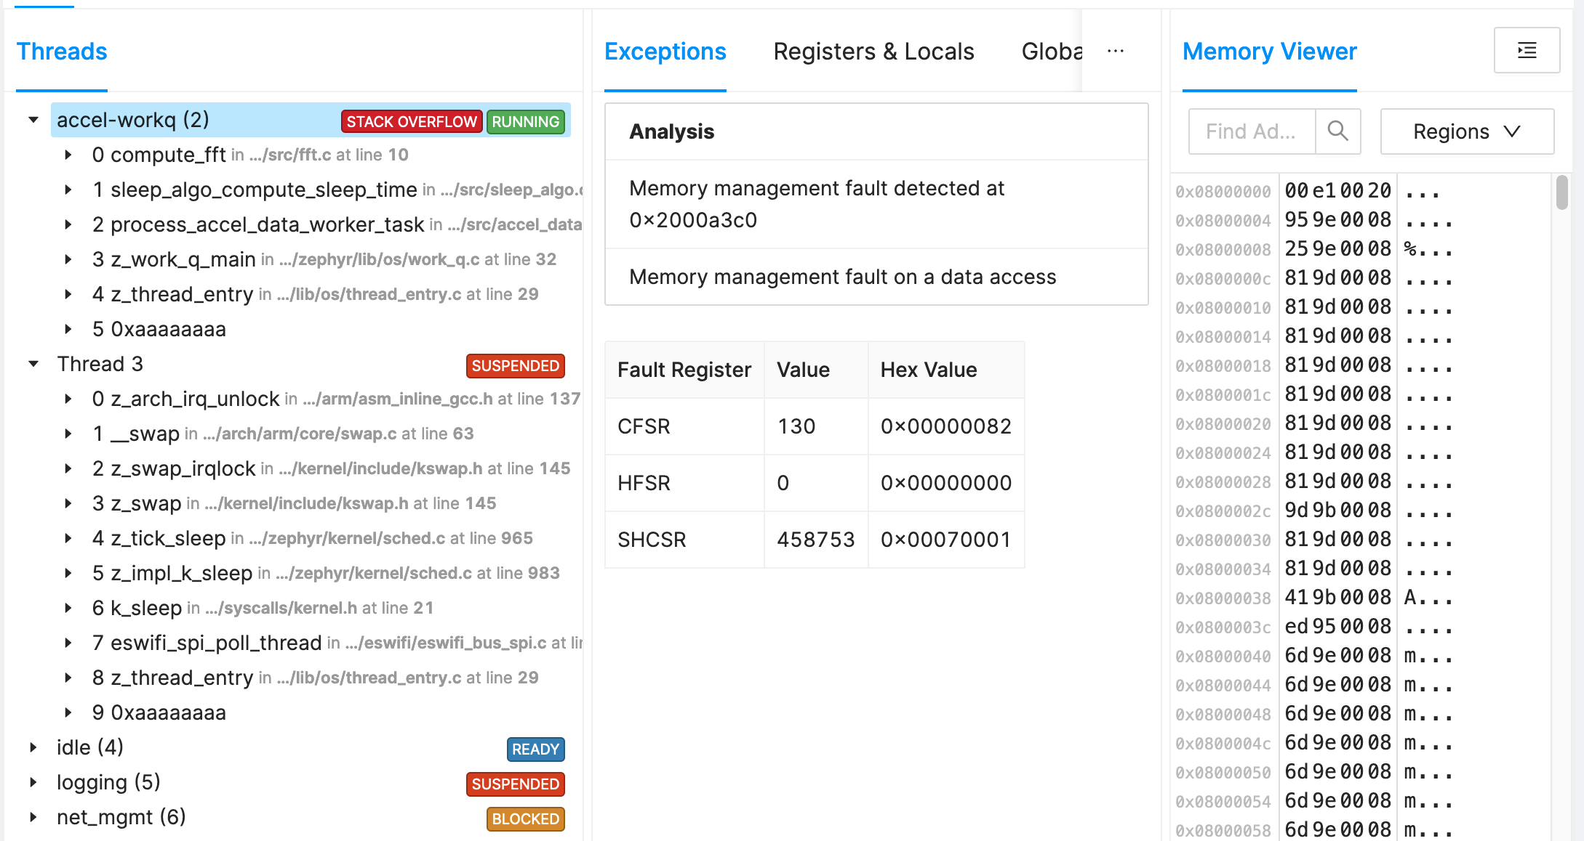

Slide 17
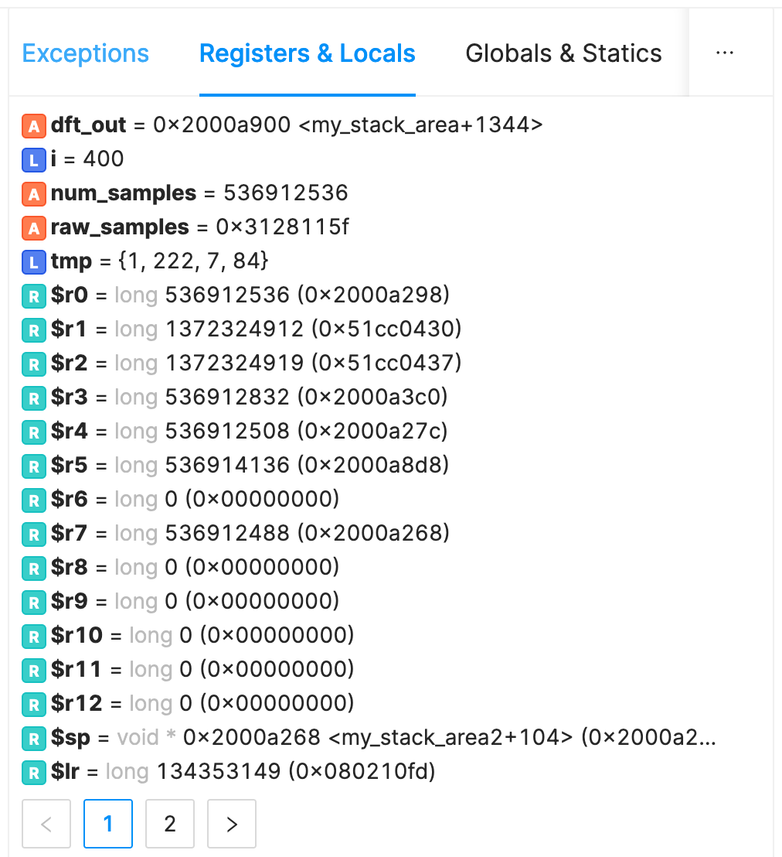
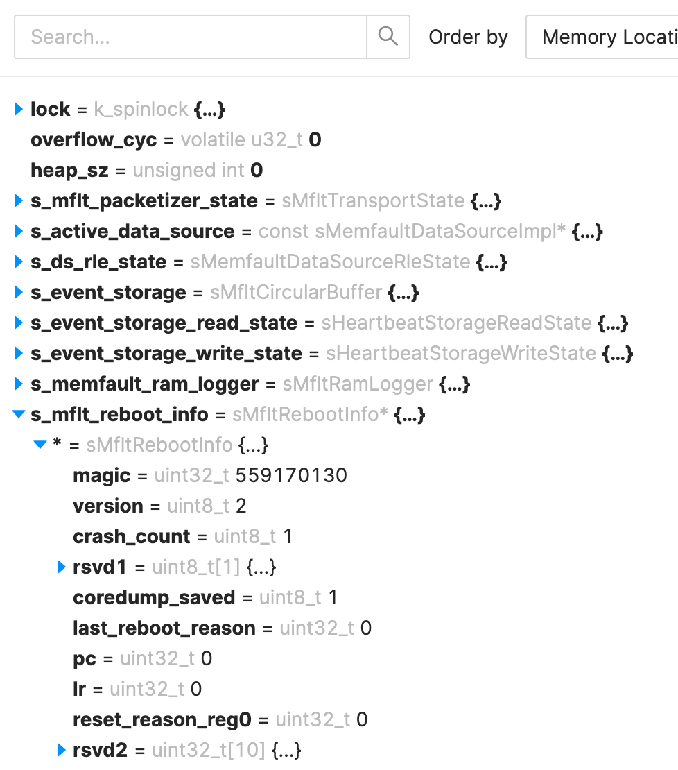

Slide 18
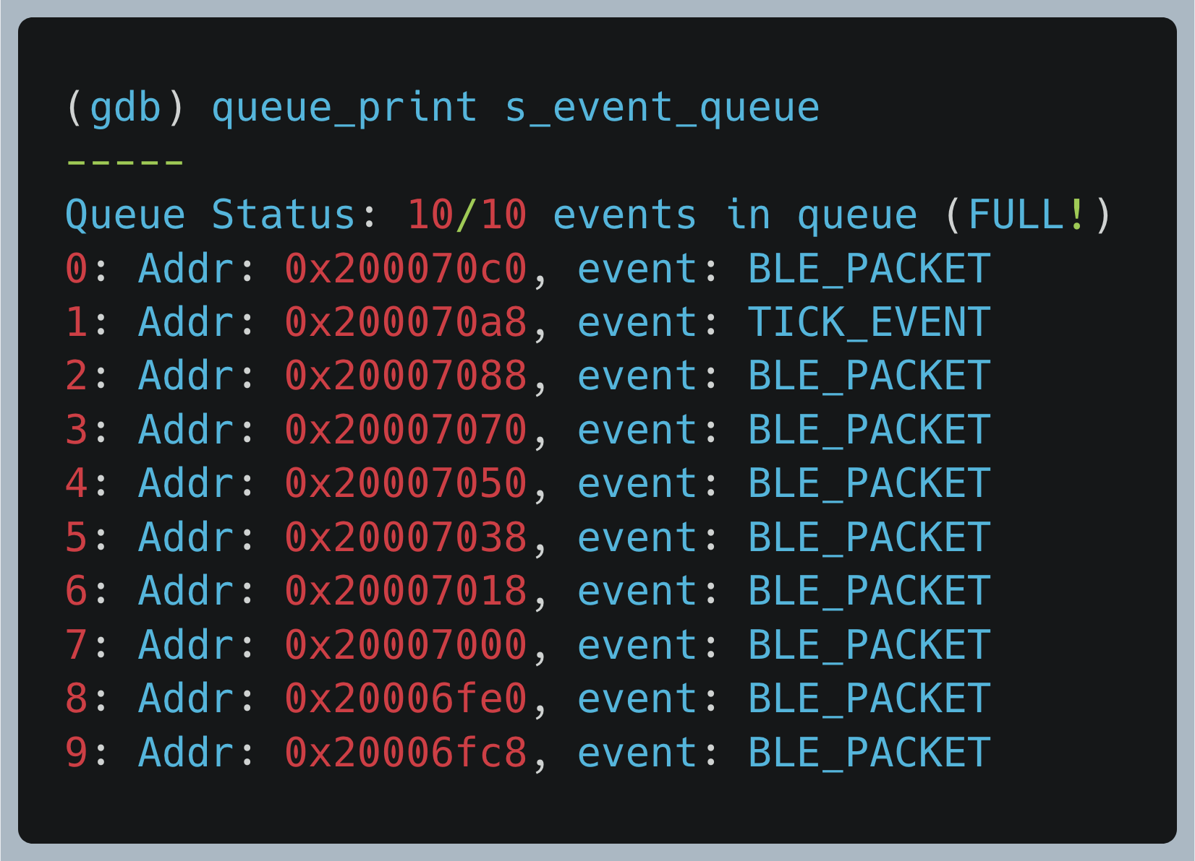
The possibilities are endless
GDB Python scripts ❤️
Decoding of internal data structures
Parsing logging circular buffer
Decoding frame buffer
Memory addressable? It’s easy to capture and load into GDB
https://interrupt.memfault.com/blog/automate-debugging-with-gdb-python-api

Slide 19

Automatic Coredump Processing
Hardfault
Look at backtrace of all threads
Investigate OS primitives (locks, etc.)
Custom investigators for global variables
And more
Deduplicate
Alert
Resolve
Central Server
Deadlock
Assert
…everything

Slide 20
Offensive Programming
Notes:
Examples
Pair with a good diagnostics system
Memfault side-by-side
Why Memfault?
Because half-way across the world!

Slide 21
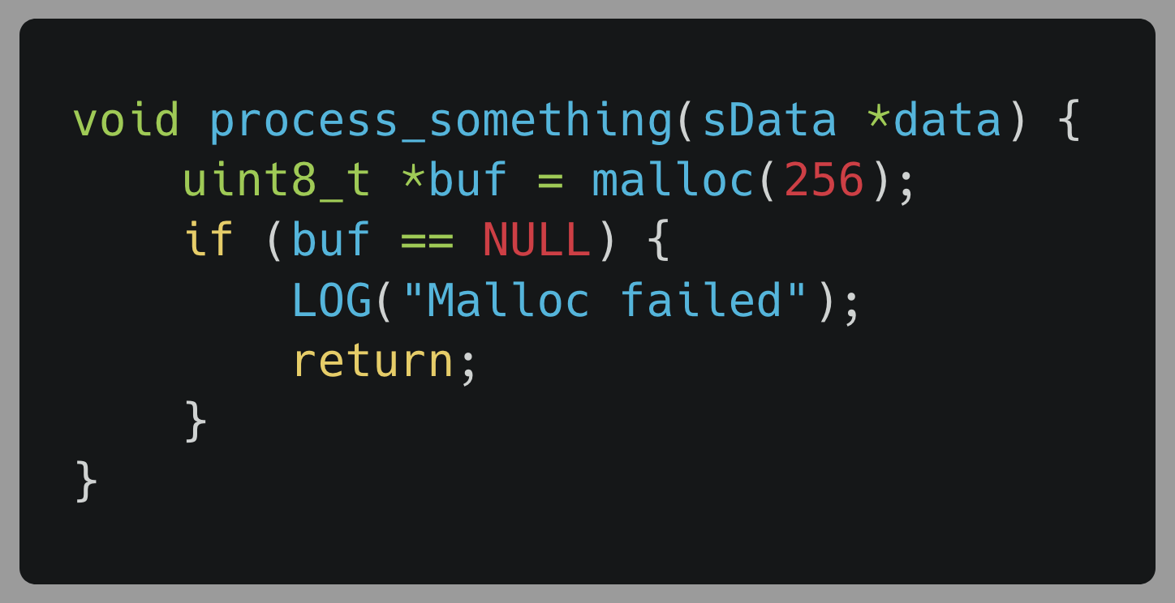
Does this look Familiar?
Notes:
We’ve all done this
Or worked in code bases like this
I’ve certainly written this code

Slide 22
It’s defensive, but poorly done
Pretends like it’s recoverable
Requires implementation knowledge
Often leads to silent failures and confusion
Someone has to eventually deal with the error. Maybe your future self.
Notes:
Handling errors that shouldn’t be handled
Pretending errors are recoverable
Memory leak – hosed
Let’s not forget poor malloc usage leads to memory corruption
Unrelated bugs

Slide 23
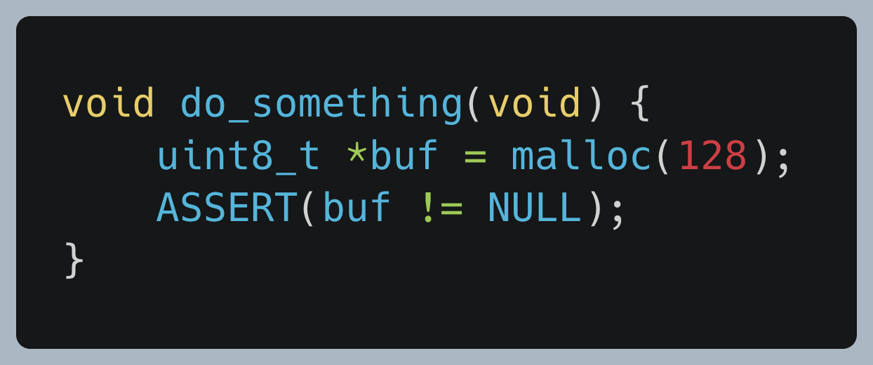
Offensive Programming
Raise errors immediately – and loudly
https://interrupt.memfault.com/blog/asserts-in-embedded-systems
Notes:
Failing fast
Read more about asserts below

Slide 24
Internal Software Modules
Internal Software
Hardware
Assert in here
3rd Party Libraries
Defensive Programming Barrier
3rd Party Applications
User Inputs
Comms Stacks
Notes:
Asserts in internal software

Slide 25
Internal Software Modules
Drivers
RTOS
Algorithms
BLE
Application
GUI
Protocols
Services
Resource
Management
State
Machines
Majority of the software stack is in our control
Notes:
Beauty and curse of firmware

Slide 26
Reasons to use Assert
Infinitely better than documentation
Asserts provide breadcrumbs (file & line number)
Raise alarms close to the root issue
Safest thing to do in undefined state is to reset
You control the assert handler
Capture extra data, logs, a coredump. Anything!
Fail fast! – especially during development and testing
Notes:
Issues will be more obscure down the line
Heap is full, memory corruption

Slide 27
Yes. Even in production (most of the time)
Wait a minute… ASSERT? Liberally!?
The problem is that our devices are now resetting with no debugger attached.
That’s where coredumps are invaluable
Notes:
What’s the point - halfway across world?
Many points!
Known state
Memfault is here to help
Friends at Sofar

Slide 28
Offensive Programming Examples
With Memfault as your “debugger”
Notes:
Examples
Pair with a good diagnostics system
Memfault side-by-side
Why Memfault?
Because half-way across the world!

Slide 29
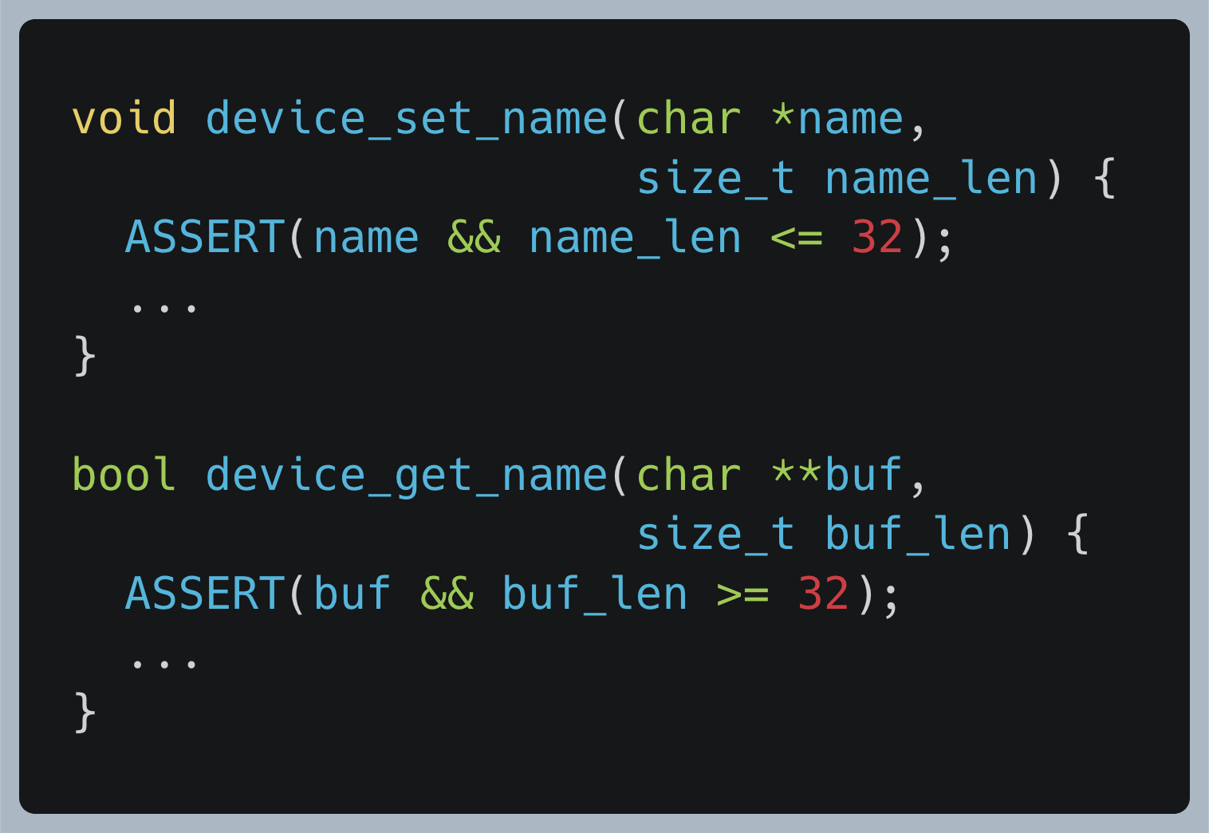
Argument Validation
Developer errors → Raise the alarm immediately
Notes:
Documentation stinks
Don’t gracefully handle bad input!
Tell them to fix their shit
Asserts are easy and useful

Slide 30
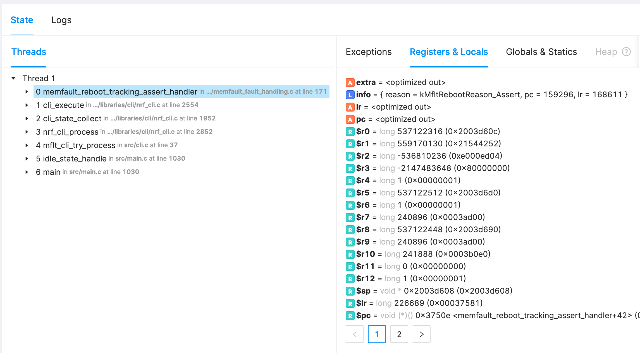
Argument Validation

Slide 31
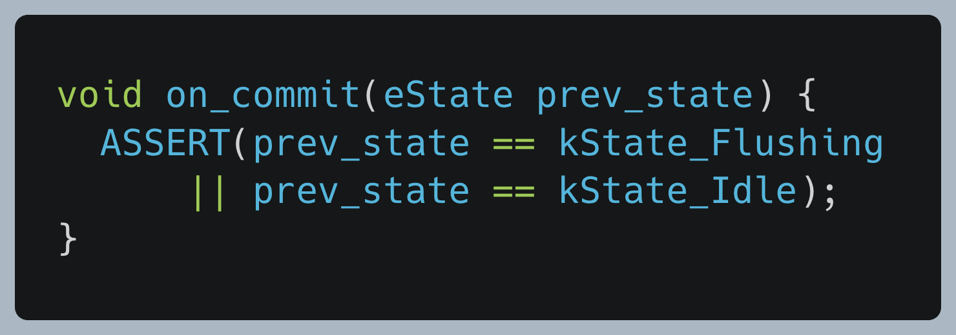
State machine transition errors
Ensure that states happen in
order and as expected

Slide 32
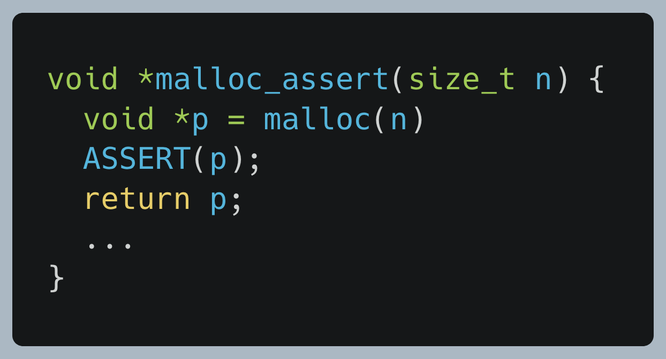
Malloc returns NULL
For allocations that should never fail
Likely means a memory leak

Slide 33
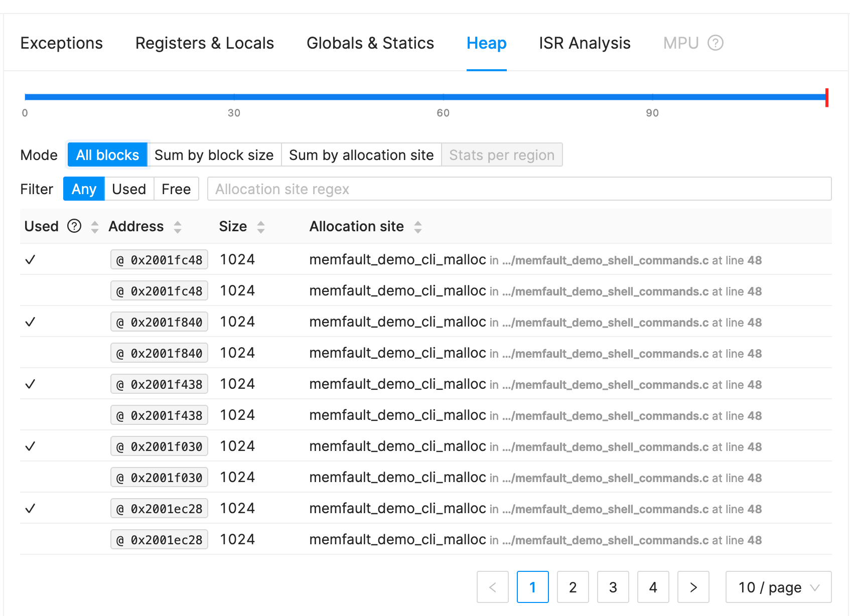
Memfault Memory View
Notes:
Customers are loving it

Slide 34
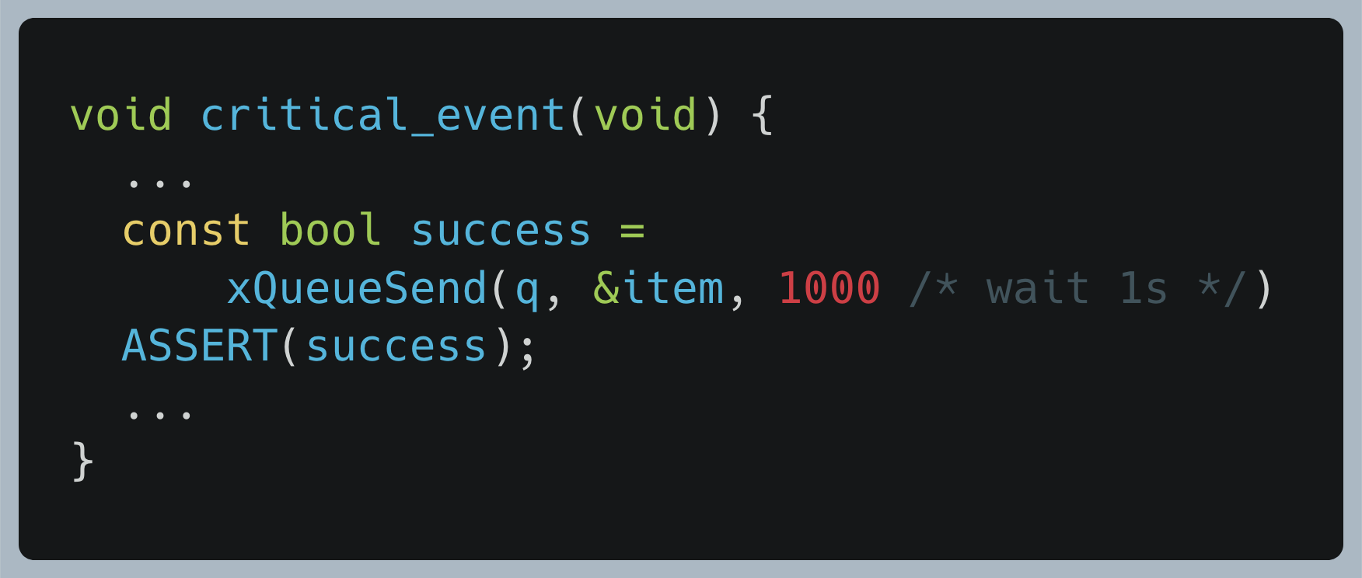
Full Queue
Track down performance issues using a timeout

Slide 35
Resource Depletion – full queue
Weren’t processing BLE packets fast enough

Slide 36
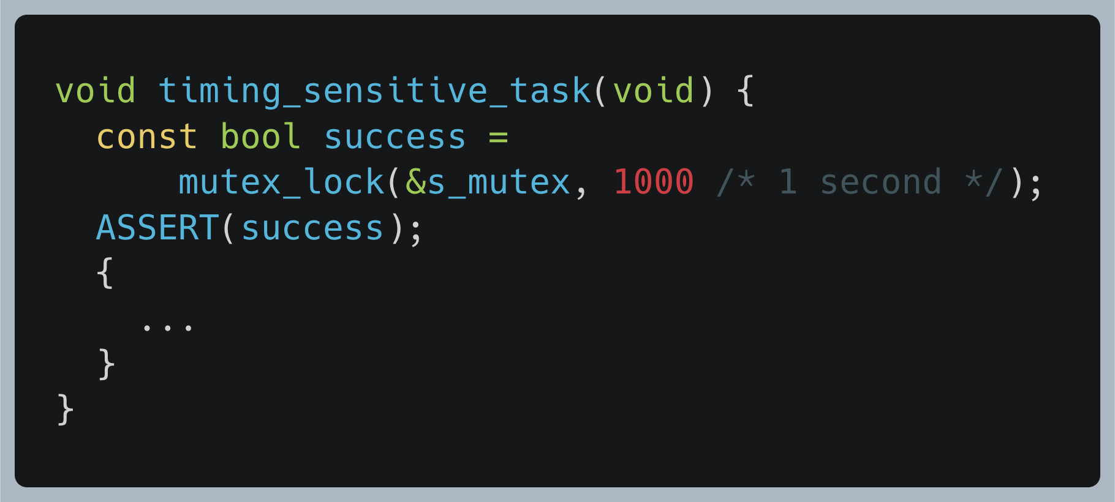
Detecting software stalls
Fail if mutex not grabbed in reasonable time

Slide 37
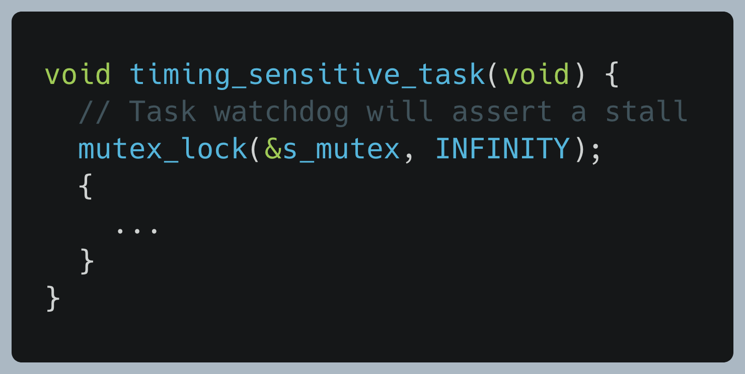
Detecting software stalls
Let the software watchdog detect the stall

Slide 38
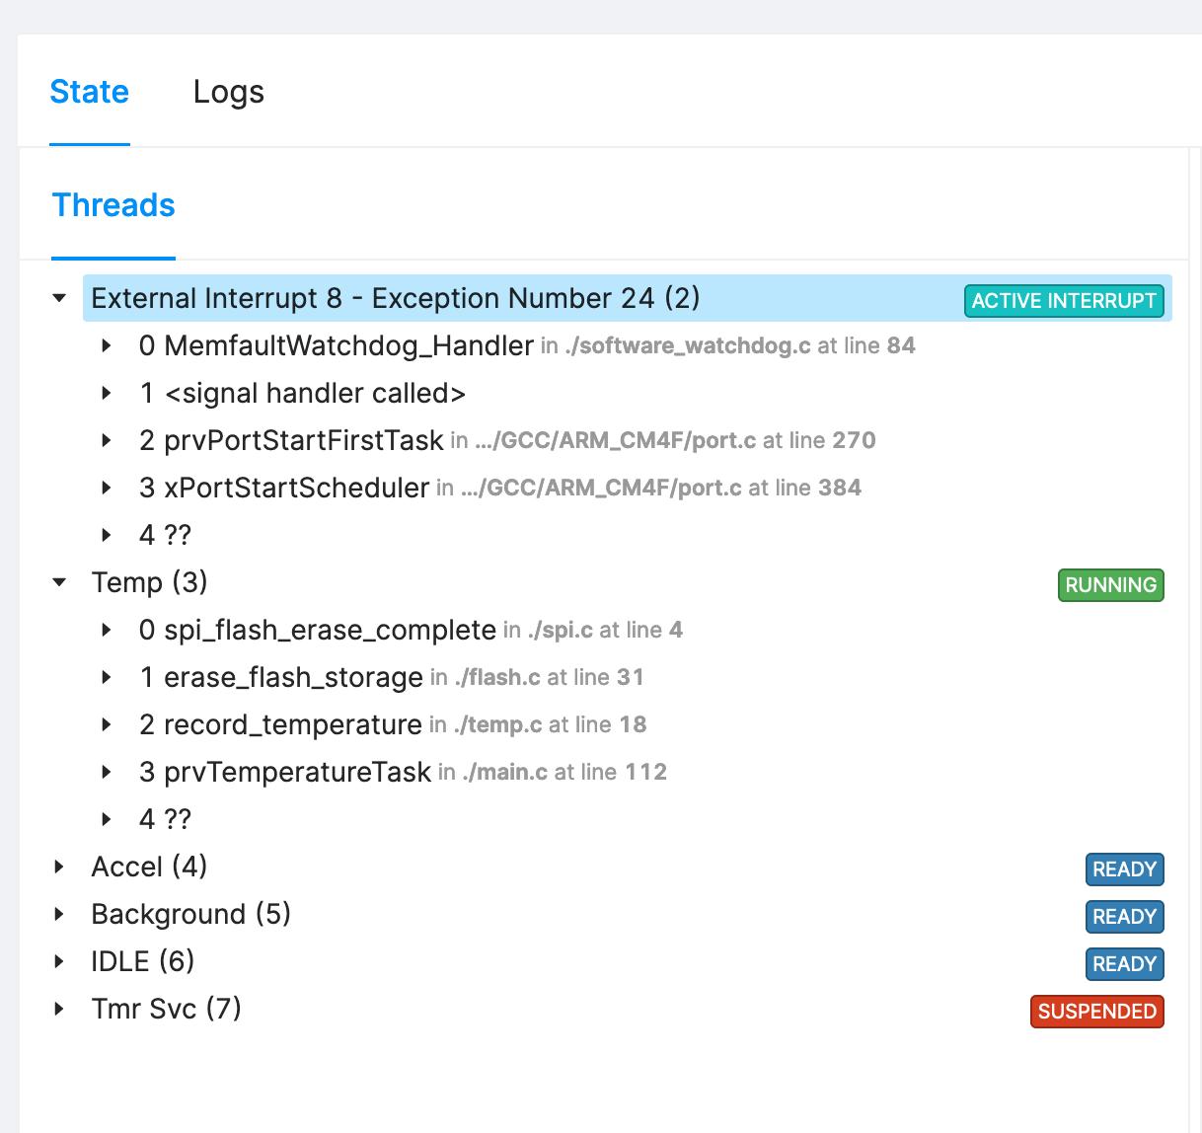
Detecting software stalls

Slide 39
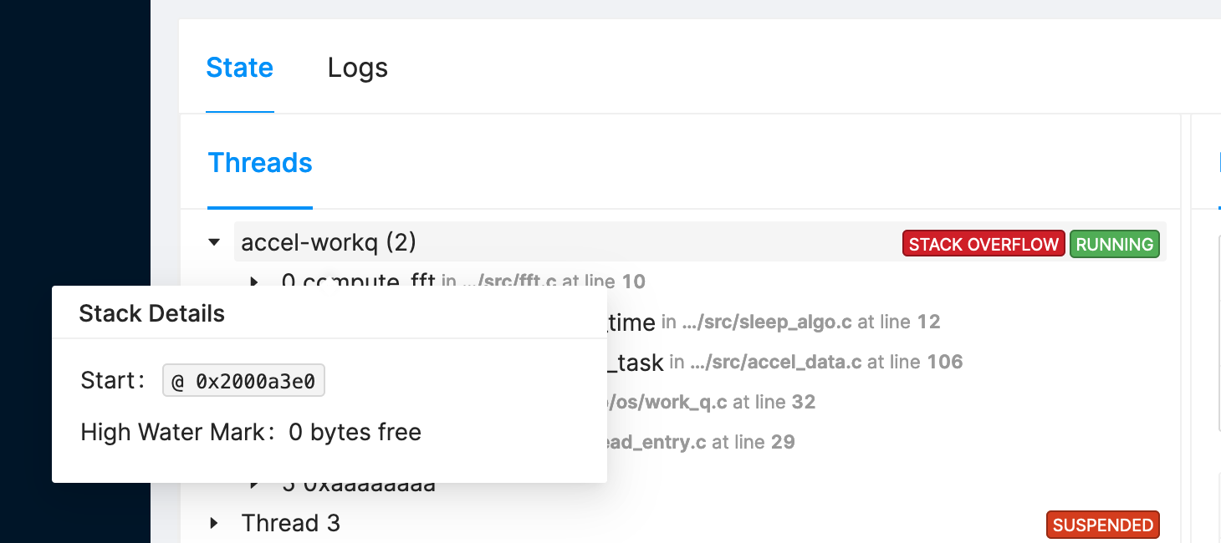
Stack Overflow Detection
Many RTOSs have this built in now. Double-check yours!
https://embeddedartistry.com/blog/2020/05/18/implementing-stack-smashing-protection-for-microcontrollers-and-embedded-artistrys-libc/
https://www.freertos.org/Stacks-and-stack-overflow-checking.html
https://docs.zephyrproject.org/latest/reference/usermode/memory_domain.html#hardware-stack-overflow
Notes:
Add stack overflow check

Slide 40
Best Practices

Slide 41

Production environments
Every bug will surface in production
Deploy Update
Assert
1 in 10,000 bugs are real
Production has the greatest matrix of test cases
Log if assertions aren’t possible in some cases
Diagnostics need to be collected
Fix
Coredump
Analyze
Offensive Programming + Diagnostics = Quicker fixes
Notes:
- QA can’t find them all
Don’t disable asserts in production!
Asserts in production = quality
Needs diagnostics and reporting

Slide 42

Watch out for boot loops
Boot loop detection is a must
You control the assert handler
Capture extra data, logs, a coredump. Anything!
Don’t assert on boot
Count # reboots within time interval
Boot into safe mode
Only FWUP, diagnostics pull, and factory reset
https://interrupt.memfault.com/blog/device-firmware-update-cookbook

Slide 43
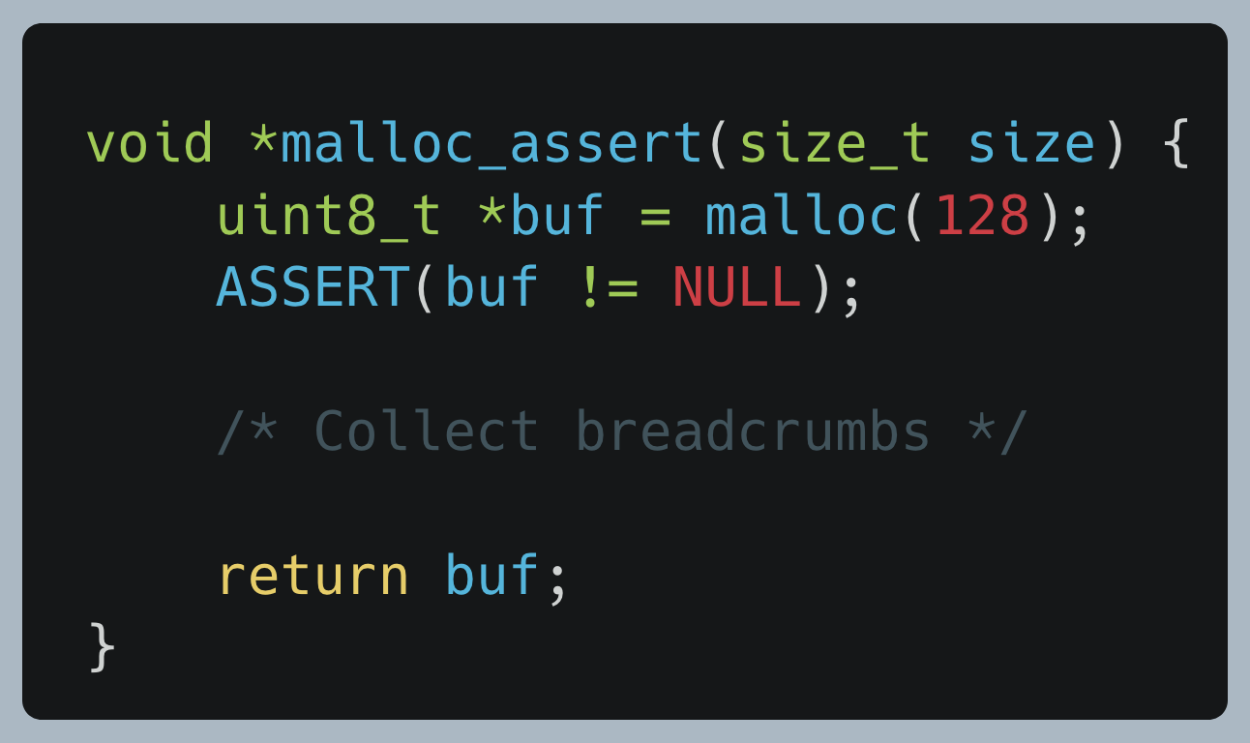
Build asserts into wrappers
Clean and simple
Notes:
- Optional usage

Slide 44

Debug builds are your friend
Internal testing is the best kind of testing
“Your Pebble just reset. Please file a bug.”
On internal builds:
Enable more aggressive asserting
Tighten timeout durations
Send builds to small groups externally
Test. Experiment. Try things. Be creative.
Every Pebble internal firmware build
Notes:
I remember builds at Pebble would crash every few minutes

Slide 45



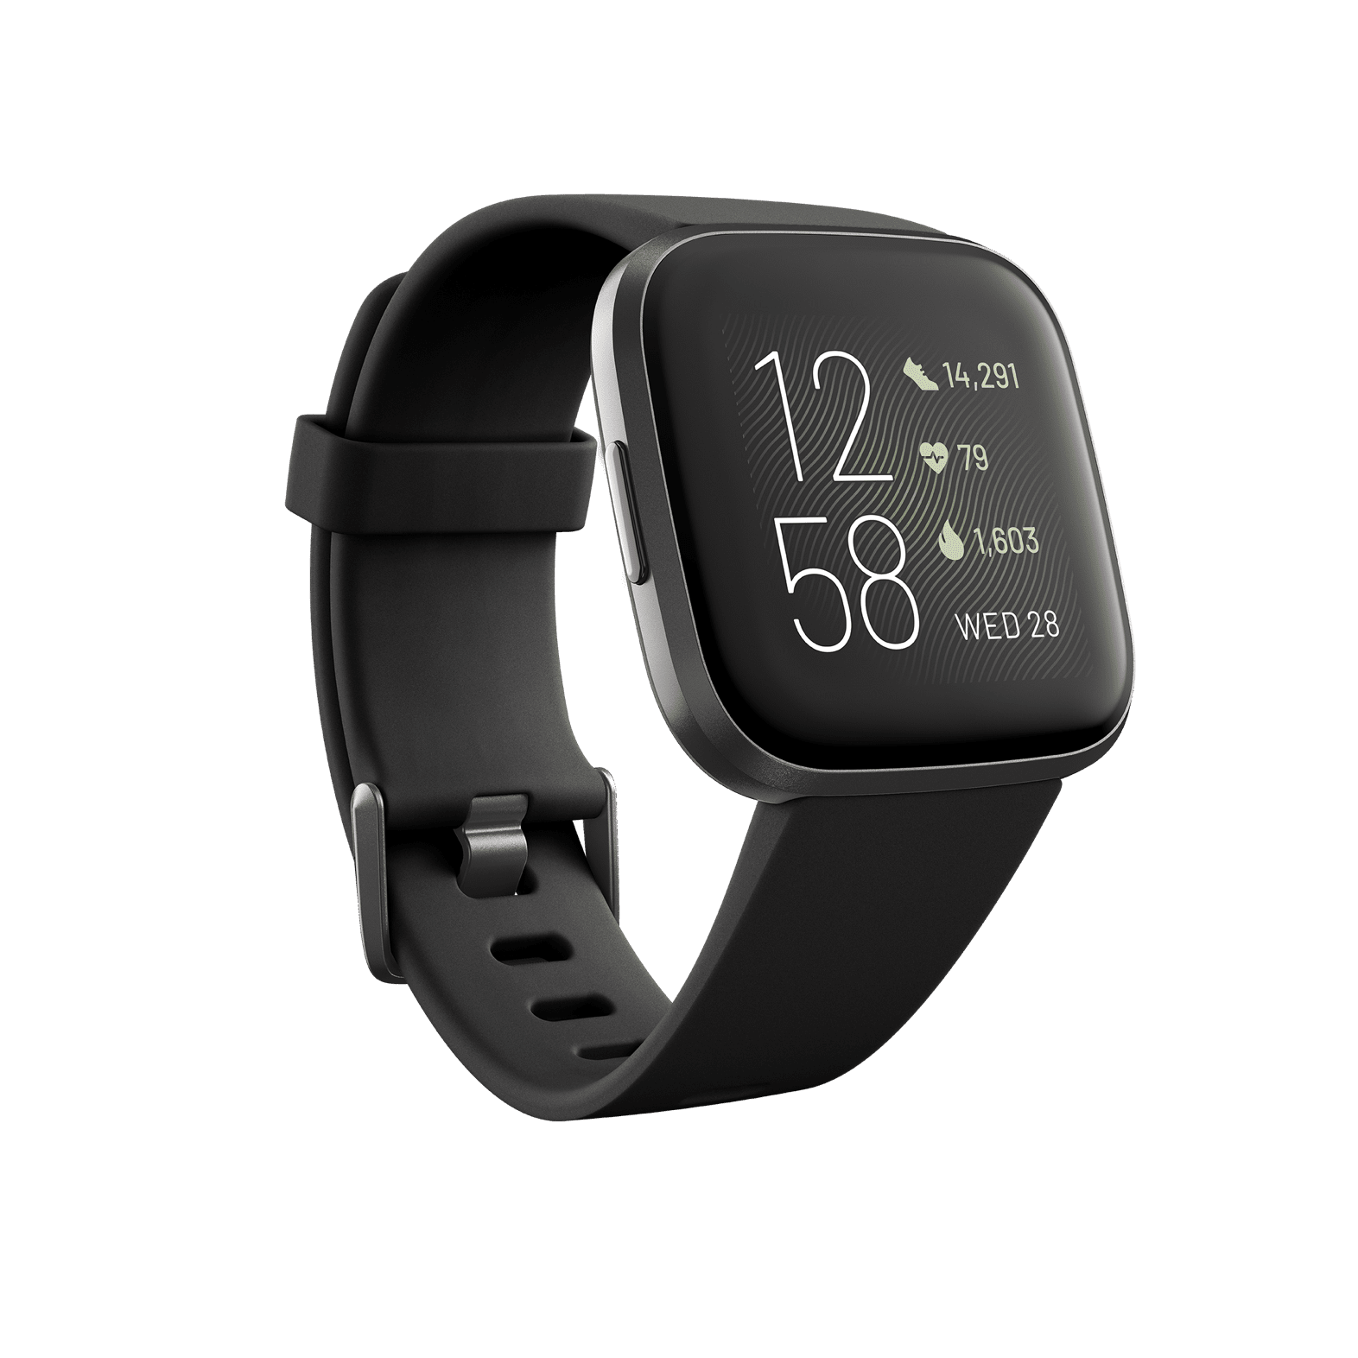
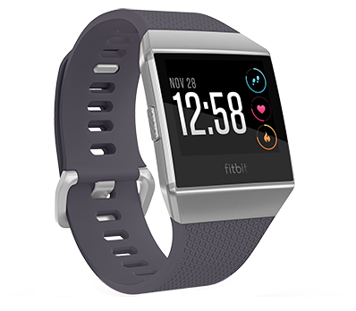



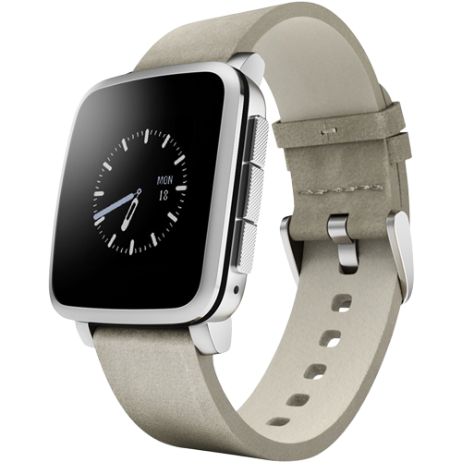



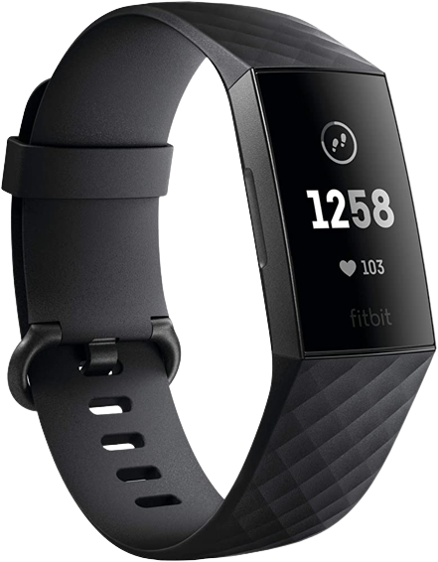


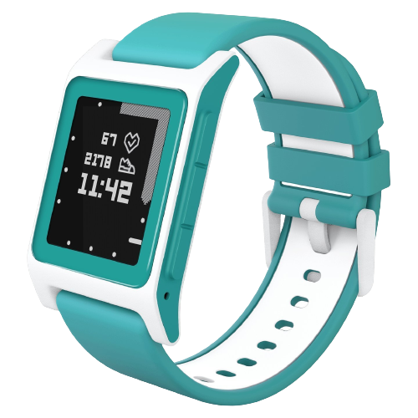



Many kinds of bugs with embedded
∞…
…and more!

Slide 46
Thank You!
memfault.com
twitter.com/memfault
linkedin.com/company/Memfault
interrupt.memfault.com
We’re hiring!
Tyler Hoffman
Co-founder, Memfault

